Slide 1


Capstone Project Bike SHARING DEMAND Prediction
(Supervised Machine Learning Regression)
Team Member:-
1) Kuresh Chandra Tripathy
2) N Santosh Kumar Choudhury

Slide 2
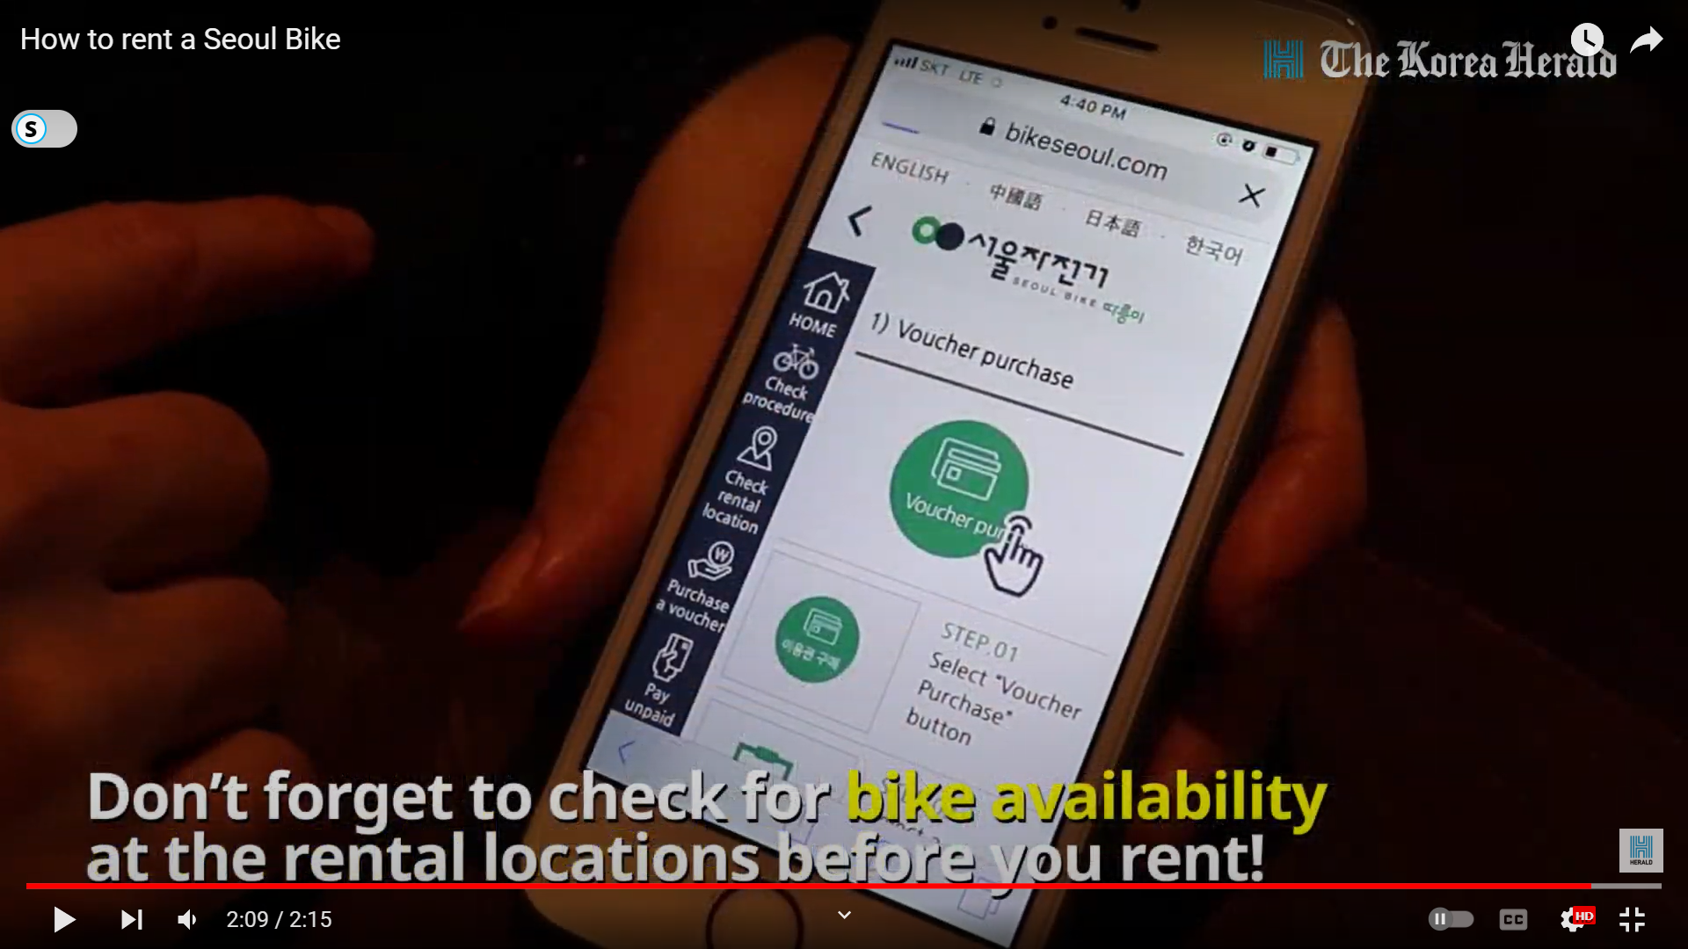



Points to Discuss:-
Agenda
Problem Statement
Workflow
Data Collection and Understanding
Data Wrangling & Feature Engineering
EDA
Preparation of data for model building.
Model Selection and Evaluation
Conclusion

Slide 3

Agenda:-
To discuss the analysis of given prediction of bike count required at each hour for the stable supply of rental bikes.
We’ll be doing analysis of given data set in the following ways:-
Problem statement
Data Collection and Understating
Data Wrangling & Feature Engineering
EDA
Preparation of data for model building.
Model Selection and Evaluation
Conclusions

Slide 4
Problem Statement:-
Currently Rental bikes are introduced in many urban cities for the enhancement of mobility comfort.
It is important to make the rental bike available and accessible to the public at the right time as it lessens the waiting time. Eventually, providing the city with a stable supply of rental bikes becomes a major concern.
The crucial part is the prediction of bike count required at each hour for the stable supply of rental bike.
The final aim of this project is the prediction of bike count required at each hour for the stable supply of rental bikes by using suitable regression model.

Slide 5
Workflow:-
Data Collection and Understanding
Data Wrangling & Feature Engineering
EDA
Preparation of data for model building.
Model Selection and Evaluation
Conclusions

Slide 6
Data Collection and Understating:-
In the above Dataset we have given Seoul bike Data for our analysis and model building. There are 14 number of features, and 8760 observations are given in the SeoulBikeData.csv file.
The dataset generally contain target/dependent variable “Ranted bike count” and independent variable like weather information, and date information.
Date : year-month-day
Rented Bike count - Count of bikes rented at each hour
Hour - Hour of the day
Temperature-Temperature in Celsius
Humidity - %
Windspeed - m/s
Visibility - 10m
Dew point temperature - Celsius
Solar radiation - MJ/m2
Rainfall - mm
Snowfall - cm
Seasons - Winter, Spring, Summer, Autumn
Holiday - Holiday/No holiday
Functional Day – NoFunc (Non-Functional Hours), Fun(Functional hours)

Slide 7
Data Wrangling and Feature Engineering:-
As we know we had 8760 observations and 14 features.
Categorical Feature: Seasons, Holiday and Function Day.
Numerical Columns: Date, Hour, Temperature, Humidity, Wind speed, Visibility, Dew point temperature, Solar radiation, Rainfall, Snowfall, Rented Bike count .
Rename Columns: We renamed columns because they had units mentioned in brackets and was difficult to copy the feature name while working.

Slide 8
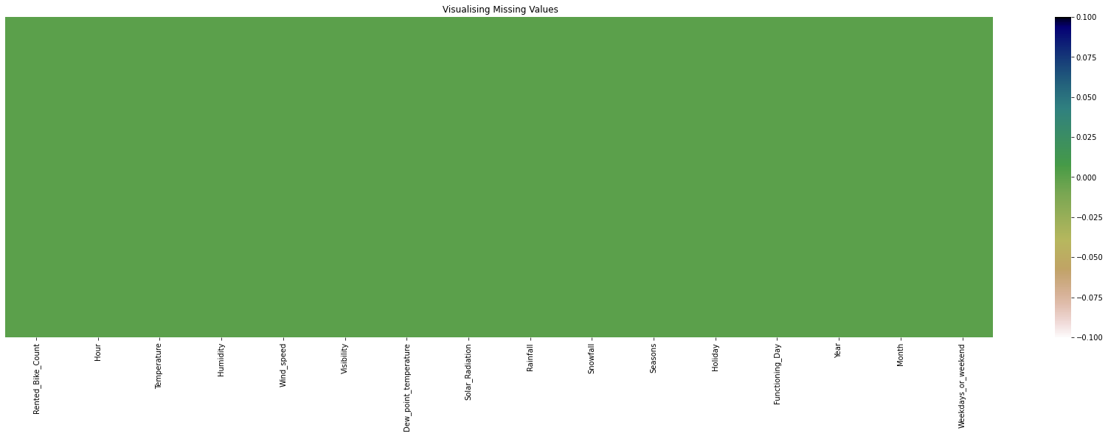
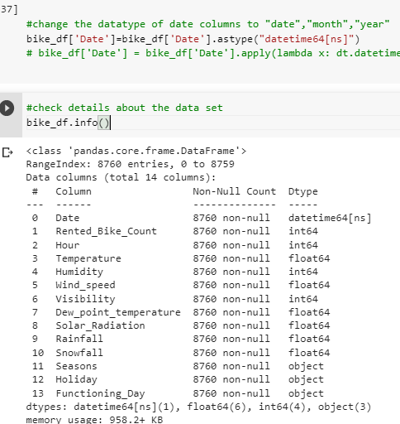
Data Wrangling and Feature Engineering:-
We had zero null values in our dataset.
Zero Duplicate entries found.
We changed the data type of Date column from ‘object’ to ‘datetime64[ns]’. This was done for feature engineering.
We Created two new columns with the help of Date column ‘Month’ and ‘Day’. Which were further used for EDA. And later we dropped Date column.

Slide 9
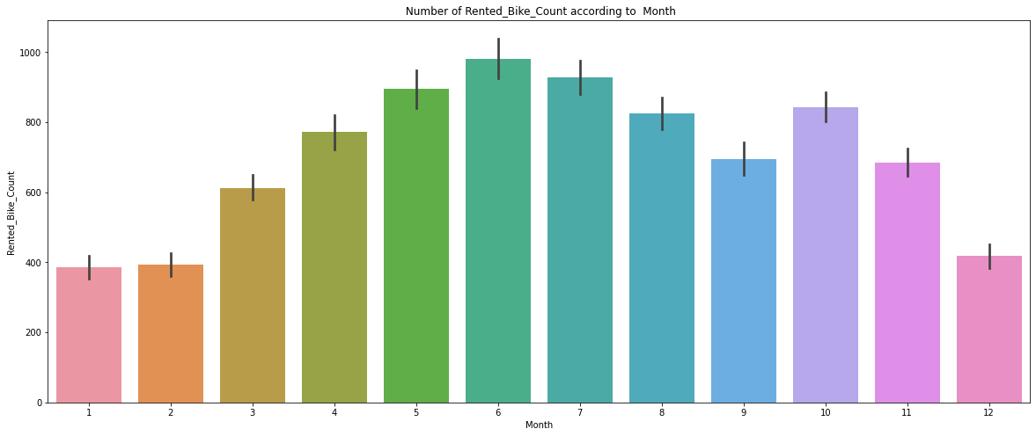
EDA (Exploratory Data Analysis):-
Relation of rented bike count with categorical features:
Rented bike vs Month
From the above bar plot is clearly showing that from Jan to Jun demand for the rented bike is growing high and then slowly the demand start dropping till Sep and than again a small demand increase for some a month and then it decrease.

Slide 10
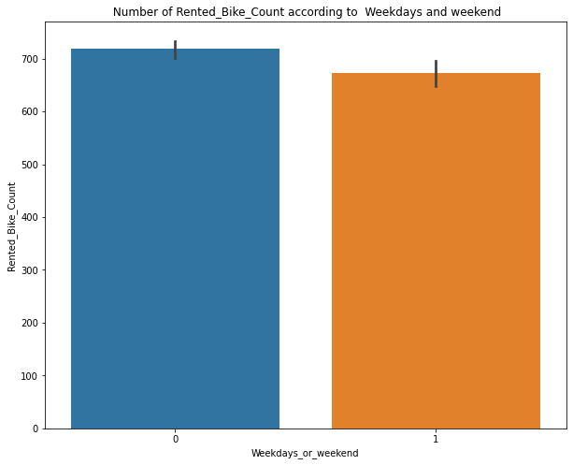
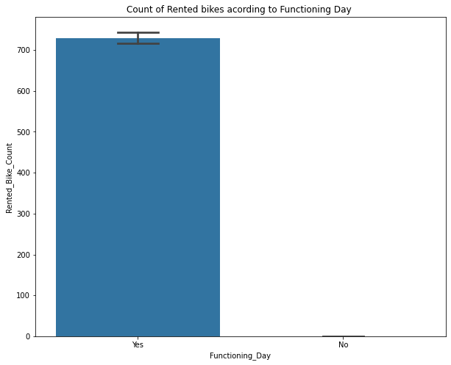
EDA (Exploratory Data Analysis):-
Rented bikes according to weekdays and weekend
From the above bar graph, it is show that in weekday and weekend days almost same demand for the bike is there.
Here 0= Weekdays and 1= Weekend
Rented bikes according to functioning days and Non- functioning days
In the above bar plot and point plot which shows the use of rented bike in functioning days or not, and it clearly shows that, Peoples don't use rented bikes in no functioning day.

Slide 11
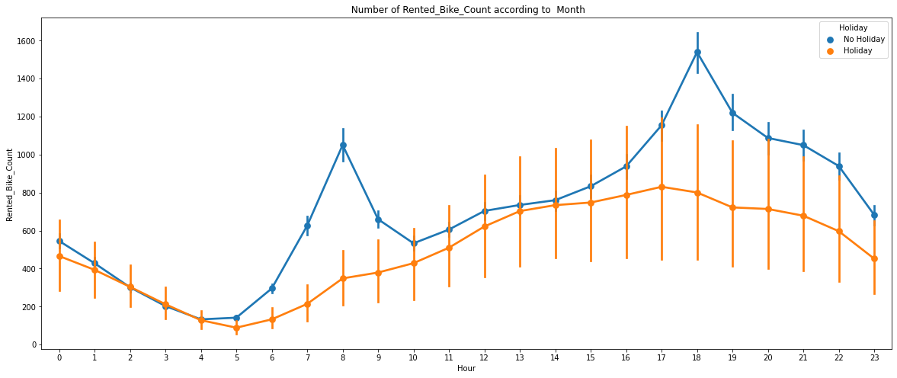
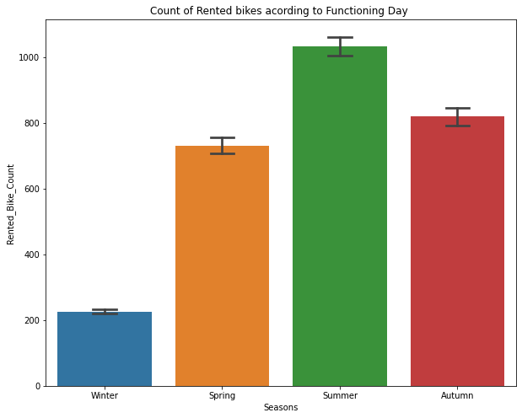
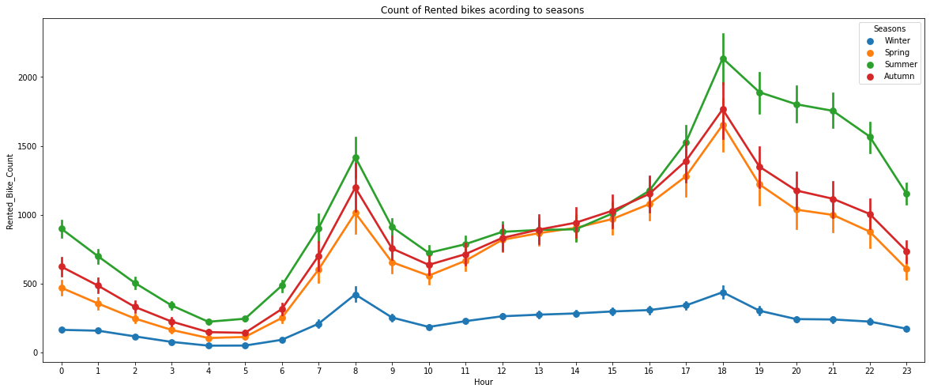
EDA (Exploratory Data Analysis):-
Rented bikes demand w.r.t hour on weekdays and weekends
From this point plot graph, we can see that on holiday ranted bike demand is less as compared to No-holiday. Between 7am-9am and 5pm-7pm demand of rented bike is high.
Rented bikes demand w.r.t Season
Form the bar chart and point plot we can clearly say that in Summer demand is high as compared to other season and in winter the demand is lowest.
Point chart also tell that in morning from 7-9am and 5-7pm demand is high in every season

Slide 12
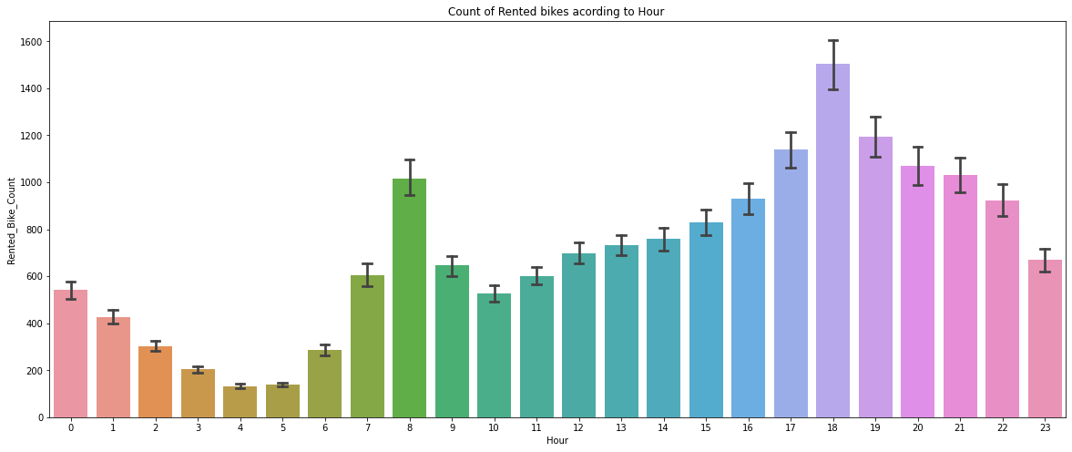
EDA (Exploratory Data Analysis):-
Rented bikes demand w.r.t hour
From this point plot graph, we can see that bike demand is high between 7am-9am and 5pm-7pm demand of rented bike is high. In between 3am-6am demand is low.

Slide 13
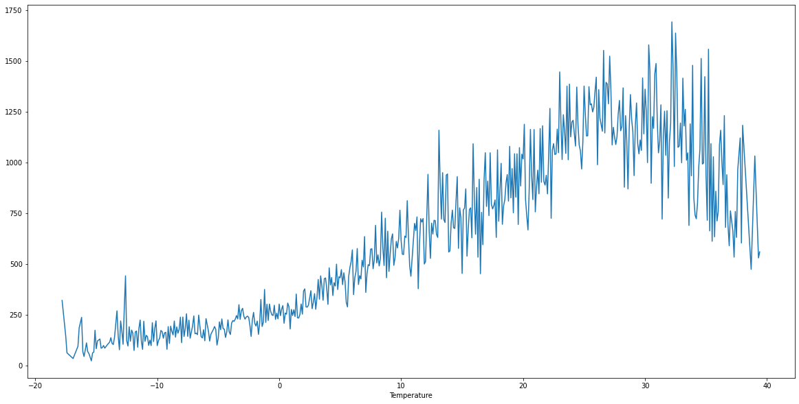
EDA (Exploratory Data Analysis):-
Relation of rented bike count with Numerical features:
Rented_Bike_Count V/s Temperature
Rented_Bike_Count V/s Dew_point_temperature
In this plot the demand of rented bike is highest when temperature is around 20°C-30°C.
This plot the demand of rented bike is highest when dew point temperature is around 20°C-30°C.
This graph also follow same trend as temperature.

Slide 14
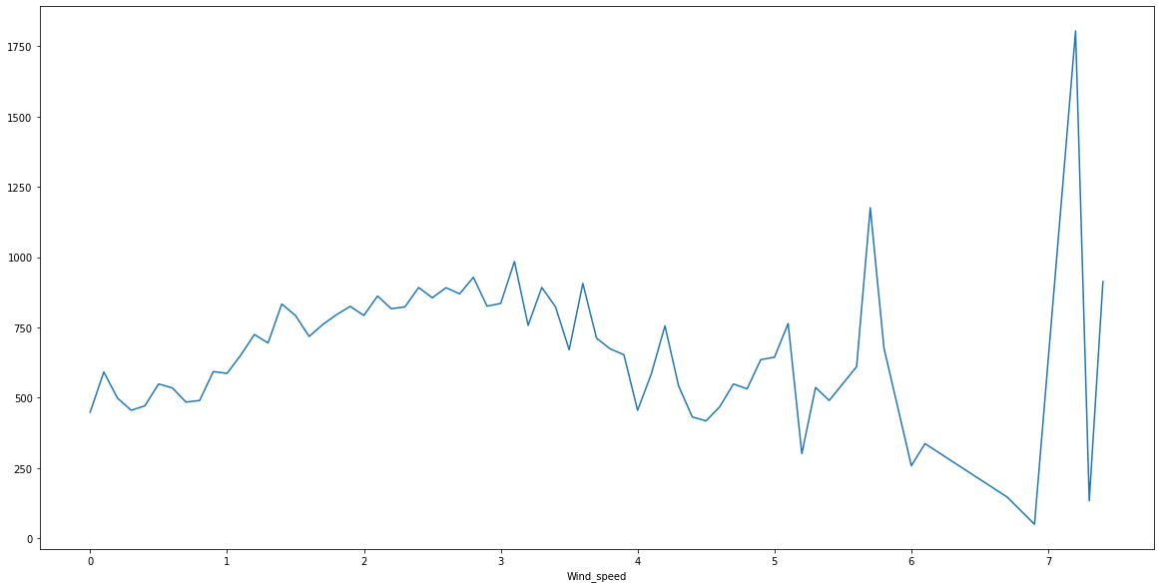
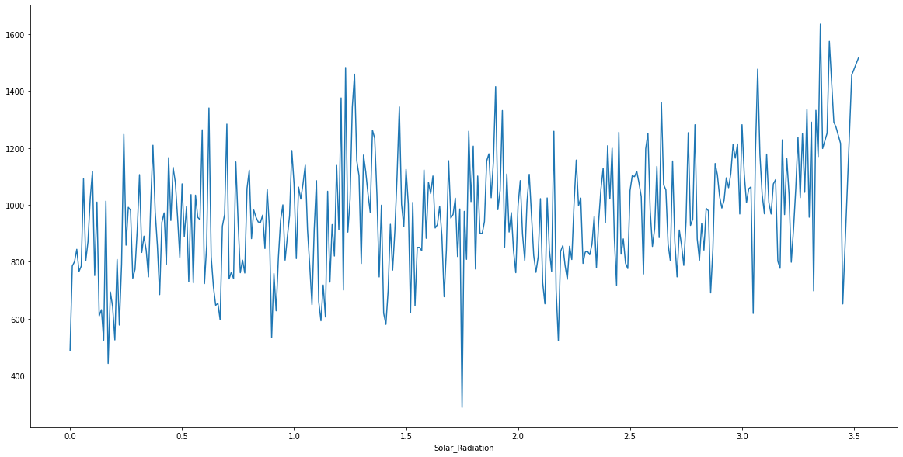
EDA (Exploratory Data Analysis):-
Relation of rented bike count with Numerical features:
Rented_Bike_Count V/s Wind_speed
Rented_Bike_Count V/s Solar Radiation
In this plot the demand of rented bike is Same throughout the wind speed/ uniformly distributed but when the wind speed is (5-6)m/s demand rises
When the wind speed is more then 7 m/s then demand for bike is also increase.
Here we can say that the patten is very random.
In this plot the demand of rented bike is high if there is solar radiation. Mostly the number is around 1000(+/-200)

Slide 15
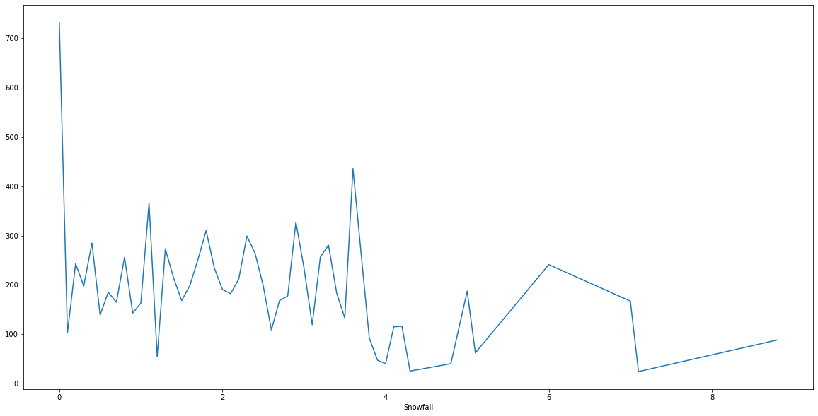
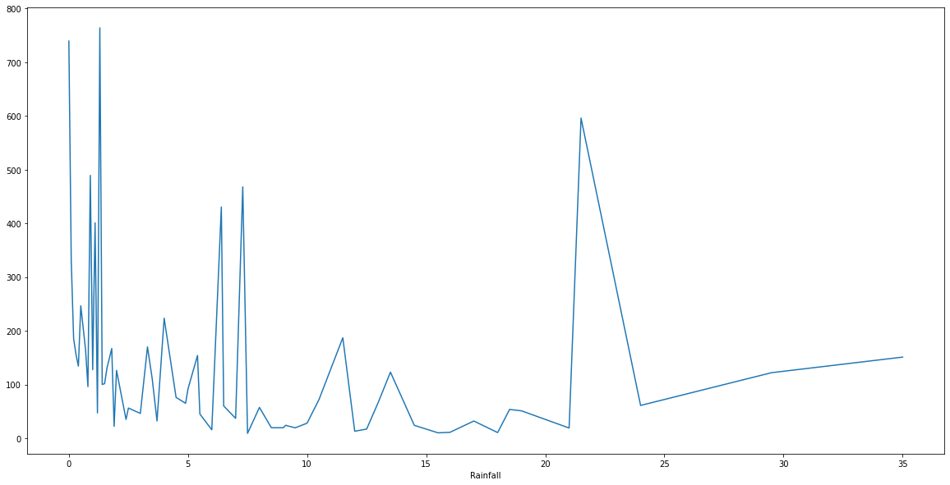
EDA (Exploratory Data Analysis):-
Relation of rented bike count with Numerical features:
Rented_Bike_Count V/s Snowfall
Rented_Bike_Count V/s Rainfall
In this plot the demand of rented bike is drastically change when snowfall is increase.
We can see from the above plot that even if it rains a lot the demand of rent bikes is not decreasing, for an example when rain is 20mm of rain big spike of rented bikes.

Slide 16
EDA (Exploratory Data Analysis):-
Relation Regression plot :-
It is a plot give a visual guide that helps to emphasize patterns in a dataset between two parameter.
Regression lines can be used as a way of visually the liner relationship between the Independent (x)----->Numerical variables and Dependent variables(y)----->Rented_Bike_Count variables here in the graphs.
The Regression plot which show the liner relation between numeric and target variable.
There are two type of liner relation present between independent and target variable.
Positively relation
Negatively relation
Positively relation:-
which means the target variable(rented bike count) increases with increase of numeric parameter.
In the regression plot of numerical features like 'Temperature', 'Wind_speed','Visibility', 'Dew_point_temperature', 'Solar_Radiation' columns are positively related with the target variaable.

Slide 17
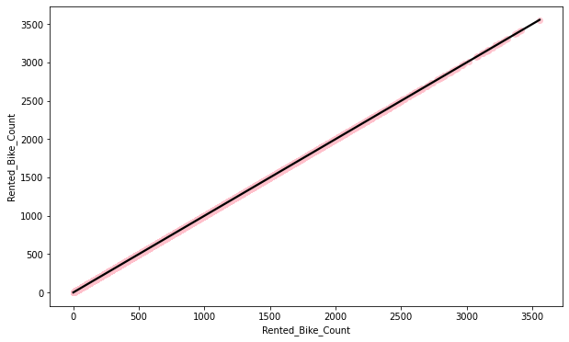
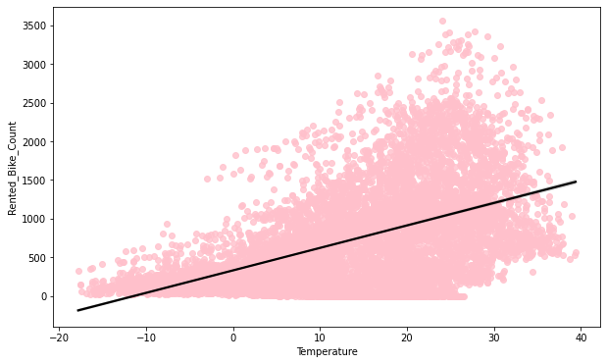
EDA (Exploratory Data Analysis):-
Relation Regression plot :-
Negatively relation:-
which means the target variable(rented bike count) decreases with increase of numeric parameter.
In the regression plot of numerical features like 'Rainfall','Snowfall','Humidity' these features are negatively related with the target variable.
Positive Relation
Positive Relation

Slide 18
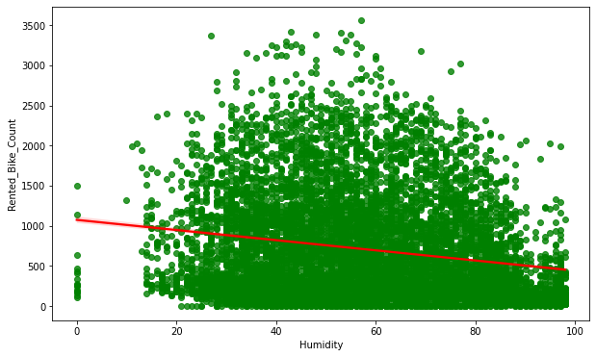
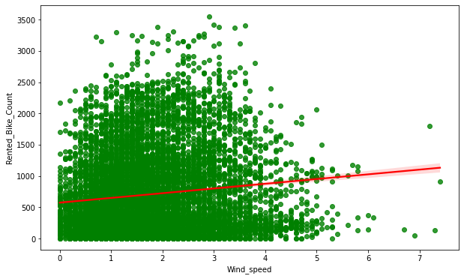
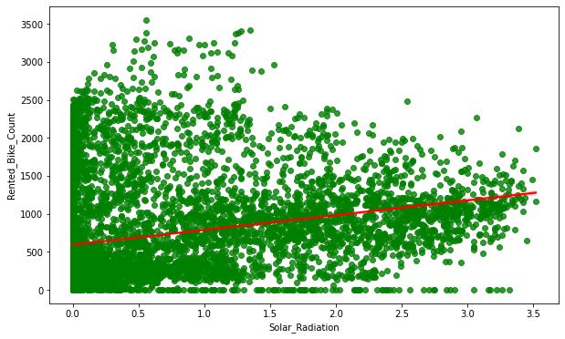
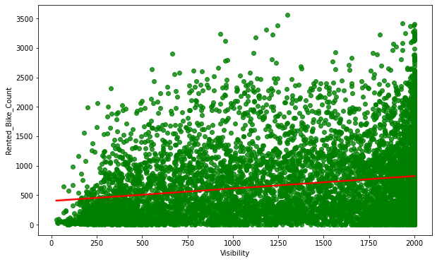
EDA (Exploratory Data Analysis):-
Negative Relation
Positive Relation
Positive Relation
Negative Relation

Slide 19
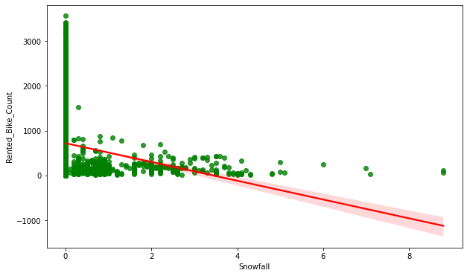
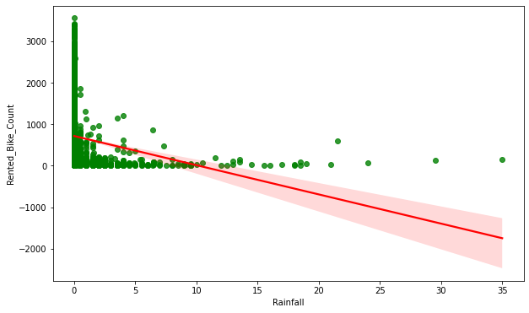
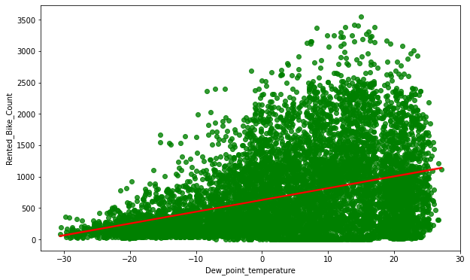
EDA (Exploratory Data Analysis):-
Negative Relation
Negative Relation
Positive Relation

Slide 20
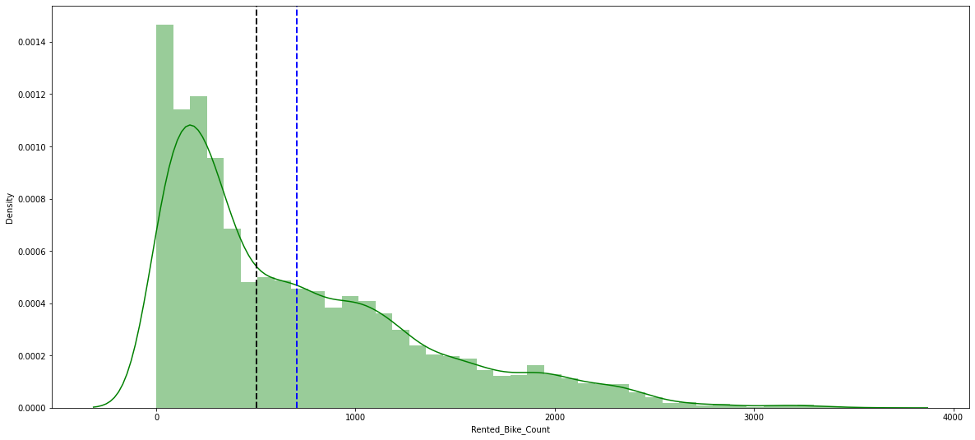
EDA (Exploratory Data Analysis):-
Normalize Rented_Bike_Count column data:-
The main purpose of data normalization is to minimize or even exclude duplicated data
The above graph show that rented bike has moderate right skewness.
As per the linear regression the distribution of target variable/dependent variable has to be normal.
We must perform some operation to make it normal.

Slide 21
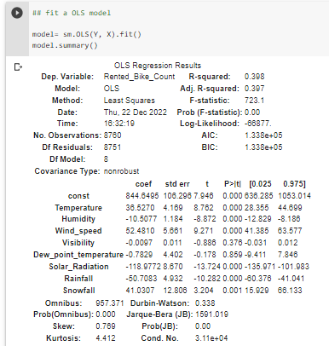
EDA (Exploratory Data Analysis):-
Checking of Correlation between variables:-
Ordinary least squares (OLS) regression is a statistical method of analysis that estimates the relationship between one or more independent variables and a dependent variable.
R square and Adj Square are near to each other. 40% of variance in the Rented Bike count is explained by the model.
For F statistic , P value is less than 0.05 for 5% level of significance.
P value of dew point temp and visibility are very high, and they are not significant.
Omnibus tests the skewness and kurtosis of the residuals. Here the value of Omnibus is high., it shows we have skewness in our data.
The condition number is large, 3.11e+04. This might indicate that there are strong multicollinearity or other numerical problems.
Durbin-Watson tests for autocorrelation of the residuals. Here value is less than 0.5. We can say that there exists a positive auto correlation among the variables.

Slide 22
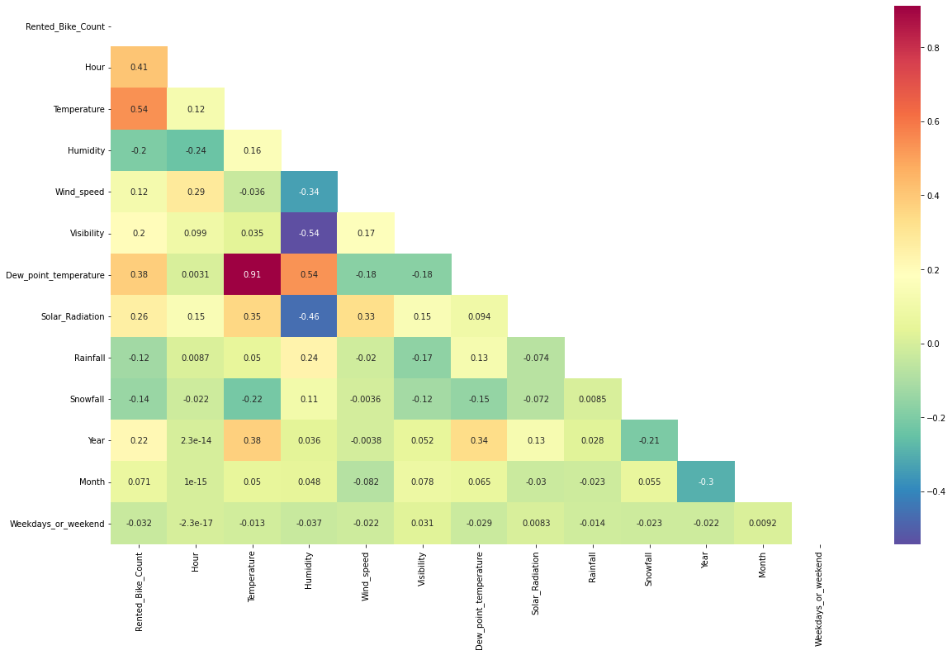
EDA (Exploratory Data Analysis):-
Checking of Correlation between variables:-
Heatmap:-
Heatmap is a matrix representation between different variable, which help to show correlation between variables by using graphical representation.
We can observe on the heatmap that on the target variable line the most positively correlated variables to the rent are:-
Temperature
Dew point temperature
Solar radiation
Most negatively correlated . variables are:-
Humidity
Rainfall

Slide 23
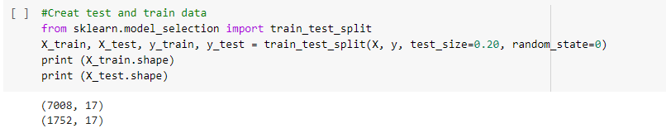
Model Training,Model Selection and Evaluation:-
Train Test split for regression:-
The train-test split is used to estimate the performance of machine learning algorithms that are applicable for prediction-based Algorithms/Applications.
Generally, the proportion may vary from 70:30,80:20,75:25 depending on the person. Mostly we prefer 80:20 ratio for the training and testing, respectively.

Slide 24
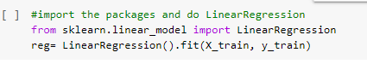
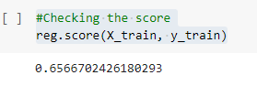
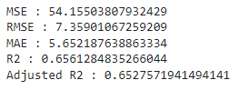
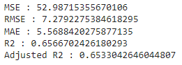
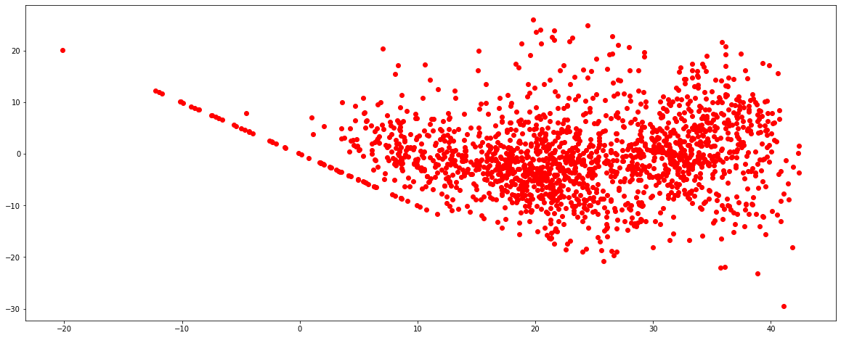
LINER REGRESSION:-
Liner regression:-
Linear regression analysis is used to predict the value of a variable based on the value of another variable. The variable you want to predict is called the dependent variable. The variable you are using to predict the other variable's value is called the independent variable.
Liner regression Score
Liner regression Value
Training Value
Testing Value
R2 score value is .65 that means our model can capture most of the data variance.
R2 score value is 0.65 that means our model can capture most of the data variance.
Heteroscedastic

Slide 25
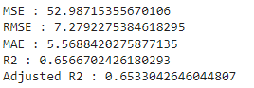
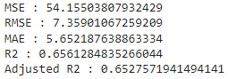
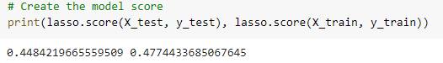
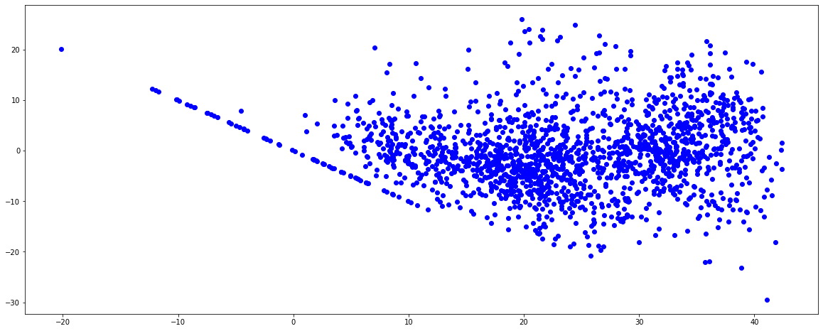
LASSO REGRESSION:-
Lasso regression:-
Lasso regression is a regularization technique. It is used over regression methods for a more accurate prediction. This model uses shrinkage.
Shrinkage is where data values are shrunk towards a central point as the mean.
Lasso regression technique also called as 'L1 regularization technique'.
Lasso regression Score
Lasso regression Value
Training Value
Testing Value
R2 score value is 0.65 that means our model can capture most of the data variance.
R2 score value is 0.65 that means our model can capture most of the data variance.
Heteroscedastic

Slide 26
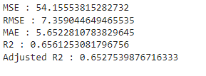
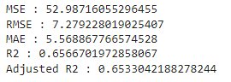
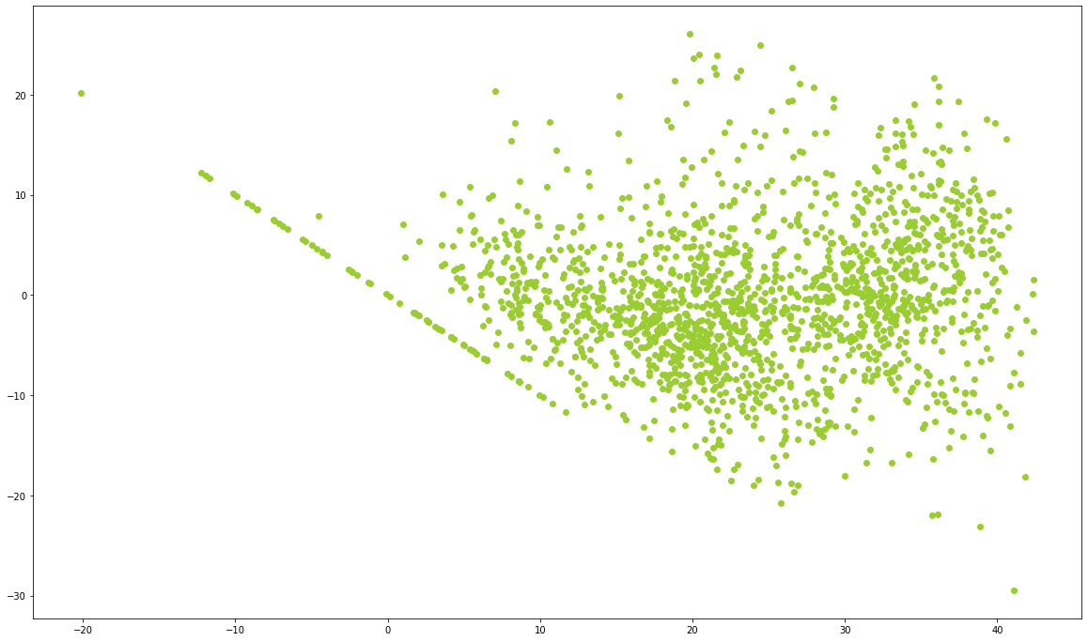
RIDGE REGRESSION:-
Ridge regression:-
Ridge regression is a method of estimating the coefficients of multiple-regression models in scenarios where the independent variables are highly correlated.
Ridge regression Score
Ridge regression Values
Training Value
Testing Value
R2 score value is 0.65 that means our model can capture most of the data variance.
R2 score value is 0.65 that means our model can capture most of the data variance.
Heteroscedastic

Slide 27
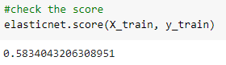
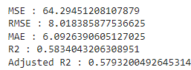
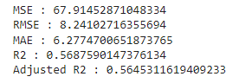
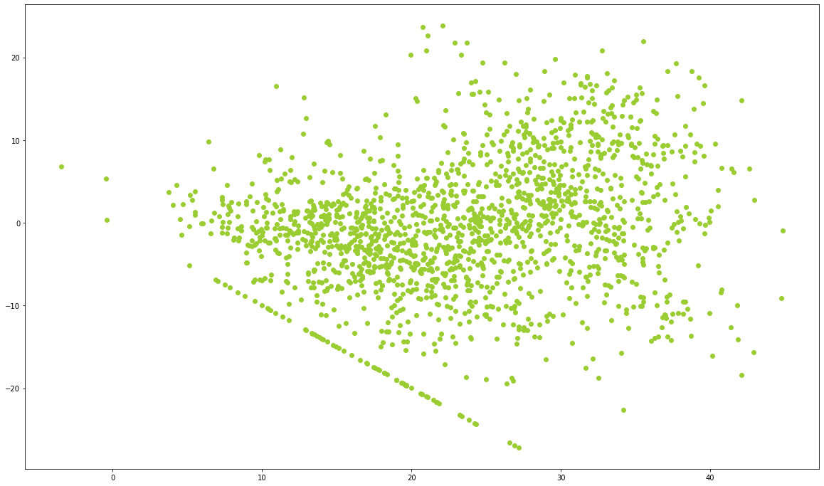
ELASTIC NET REGRESSION:-
Elastic Net regression:-
Elastic net linear regression uses the penalties from both the lasso and ridge techniques to regularize regression models.
Elastic Net regression Score
Elastic Net regression Value
Training Value
Testing Value
R2 score value is 0.58 that means our model can capture most of the data variance.
R2 score value is 0.56 that means our model can capture most of the data variance.
Heteroscedastic

Slide 28
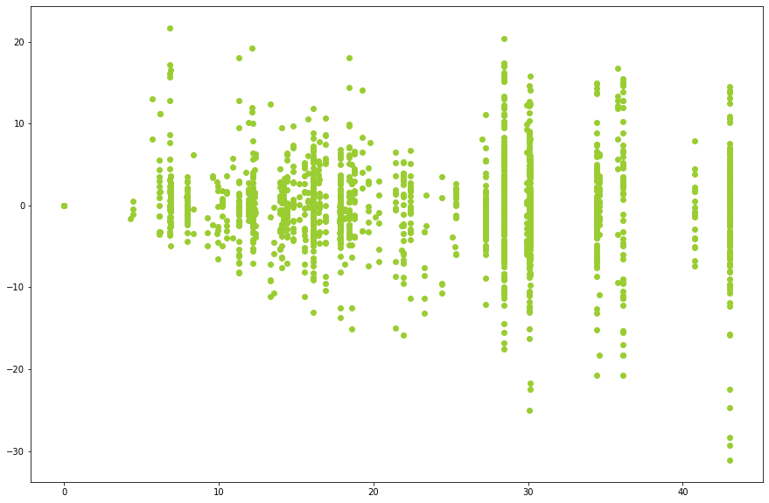
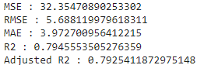
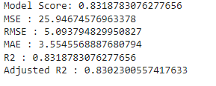
ELASTIC NET REGRESSION:-
Decision Tree:-
Decision tree regression observes features of an object and trains a model in the structure of a tree to predict data in the future to produce meaningful continuous output.
Decision Tree Value
Model Score & Training Value
Testing Value
R2 score value is 0.83 that means our model can capture most of the data variance.
R2 score value is 0.79 that means our model can capture most of the data variance.
Heteroscedastic

Slide 29
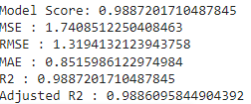
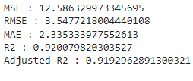
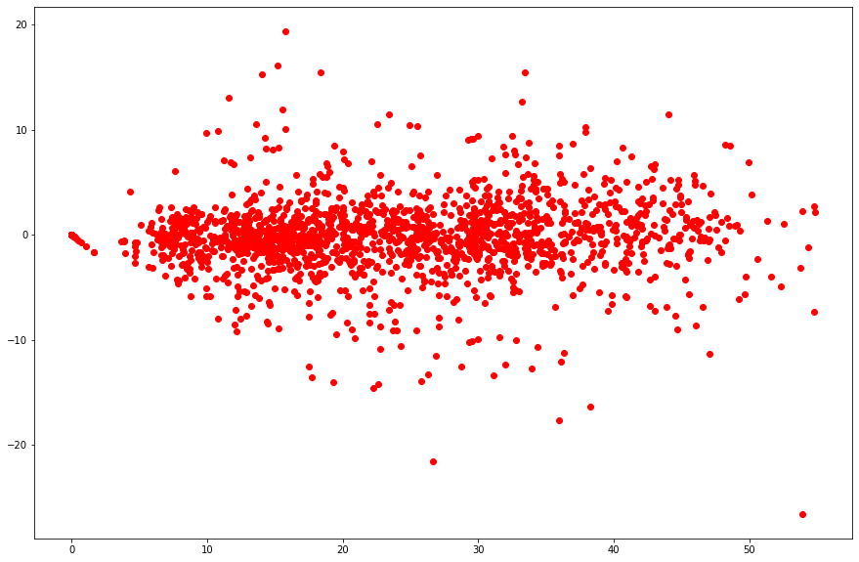
RANDOM FOREST REGRESSION:-
Random Forest:-
The random forest is a classification algorithm consisting of many decisions trees. It uses bagging and feature randomness when building each individual tree to try to create an uncorrelated forest of trees whose prediction by committee is more accurate than that of any individual tree.
Random Forest Value
Model Score & Training Value
Testing Value
R2 score value is 0.99 that means our model can capture most of the data variance.
R2 score value is 0.92 that means our model can capture most of the data variance.
Heteroscedastic

Slide 30


REGRESSION IMPORTANCE :-
Feature Importance:-
From the below Dataset we can understand the important features which will important and impact the most with respect to the dependent variable ‘Rented_Bike_Count’

Slide 31



GRADIENT BOOSTING:-
Gradient Boosting:-
Gradient boosting is a machine learning technique used in regression and classification tasks, among others. It gives a prediction model in the form of an ensemble of weak prediction models, which are typically decision trees.
Gradient Boosting Value
Model Score & Training Value
Testing Value
R2 score value is 0.89 that means our model can capture most of the data variance.
R2 score value is 0.88 that means our model can capture most of the data variance.
Heteroscedastic

Slide 32


GRADIENT BOOSTING:-
Gradient Boosting Feature Importance

Slide 33




HYPERPARAMETER TUNING:-
Hyperparameter tuning (or hyperparameter optimization) is the process of determining the right combination of hyperparameters that maximizes the model performance. It works by running multiple trials in a single training process.
ach trial is a complete execution of your training application with values for your chosen hyperparameters, set within the limits you specify.
This process once finished will give you the set of hyperparameter values that are best suited for the model to give optimal results
There are two type way to tuning hyperparameter
GridSearchCV
RandomizedSearchCV
Hyperparameter tuning
Hyperparameter used GridSearchCV Value
Model Score & Training Value
Testing Value
R2 score value is 0.96that means our model can capture most of the data variance.
R2 score value is 0.92 that means our model can capture most of the data variance.

Slide 34


HYPERPARAMETER TUNING:-
Hyperparameter Feature Importance

Slide 35


CONCLUSION:-
Random forest Regressor and Gradient Boosting gridsearchcv gives the highest R2 score of 99% and 96% respectively for Train Set and 92% for Test set.
Feature Importance value for Random Forest and Gradient Boost are different.
• We can deploy this model.
Adjusted R2-Values

